Slide 1
Part 4 Chapter 14
Linear Regression

Slide 2
Chapter Objectives
Knowing how to compute the slope and intercept of a best fit straight line with linear regression.
Understanding how to use transformations to linearize nonlinear equations so that they can be fit with linear regression.
Knowing how to implement linear regression with MATLAB.

Slide 3
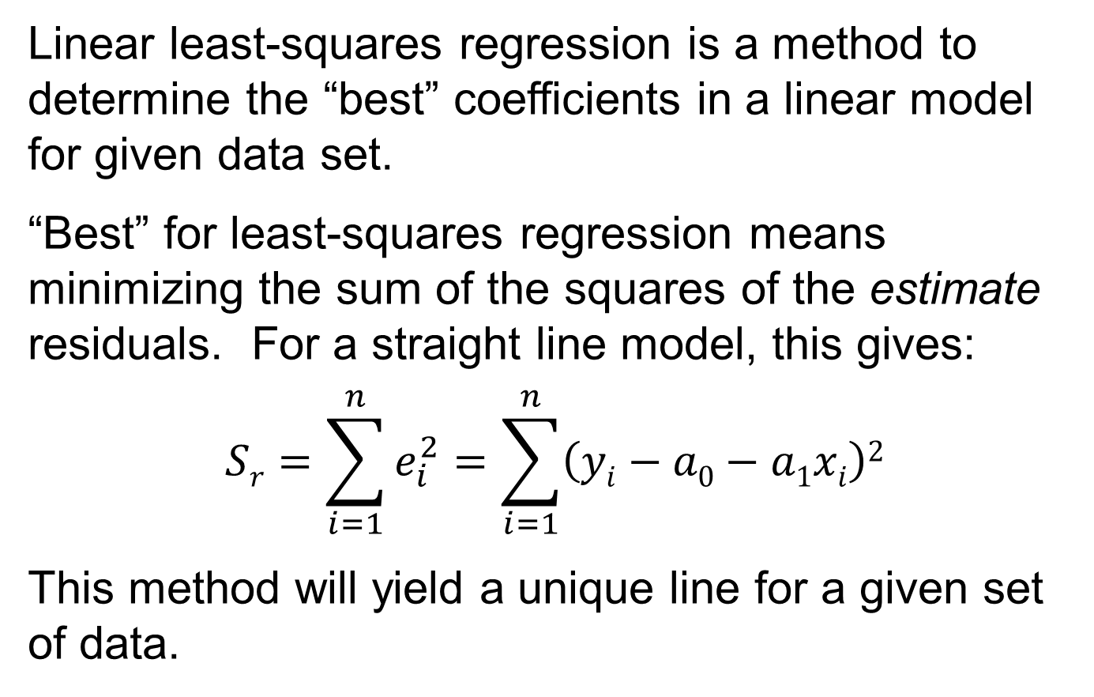
Linear Least-Squares Regression
Linear least-squares regression is a method to determine the “best” coefficients in a linear model for given data set.
“Best” for least-squares regression means minimizing the sum of the squares of the estimate residuals. For a straight line model, this gives:
$$Sr=\sum_{i=1}^{n}{e_{i}^{2}=\sum_{i=1}^{n}{\left(yi−a0−a1xi\right)2}}$$
This method will yield a unique line for a given set of data.

Slide 4
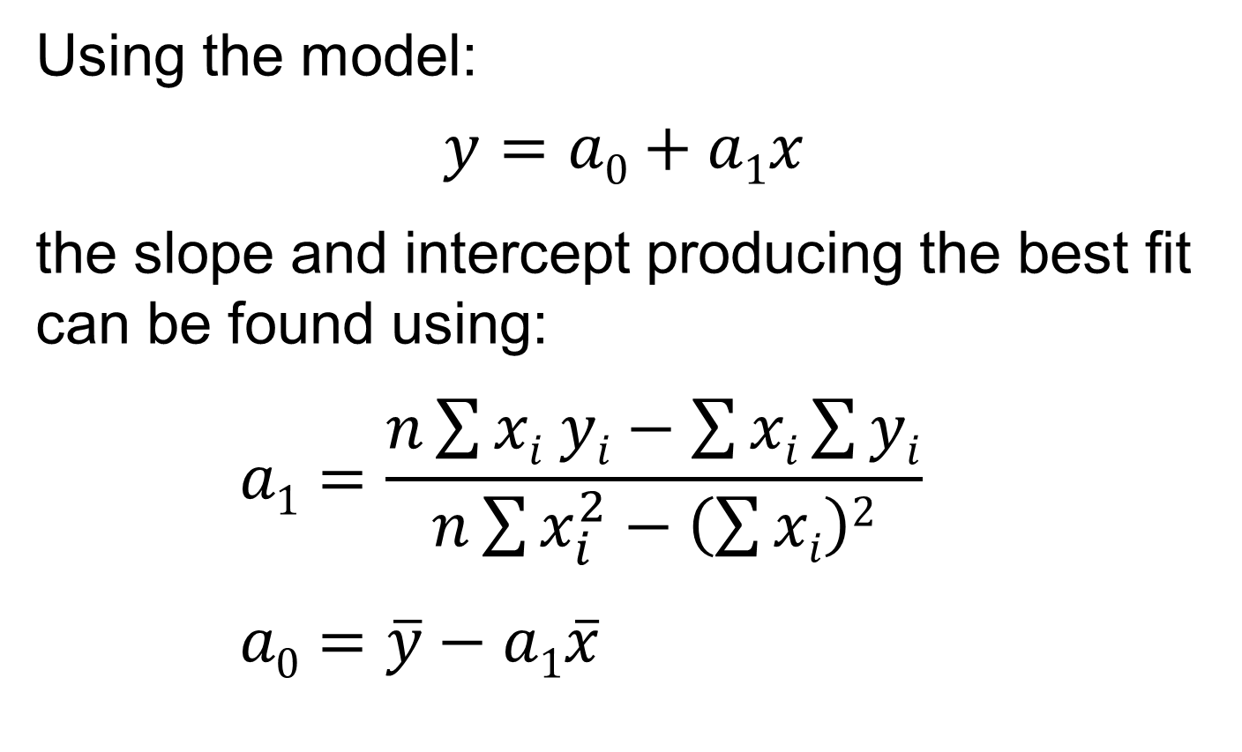
Least-Squares Fit of a Straight Line
Using the model:
$$y=a0+a1x$$ the slope and intercept producing the best fit can be found using:
$$a1=\frac{n\sum{xi yi}−\sum{xi}\sum{yi}}{n\sum{x_{i}^{2}−\left(\sum{xi}\right)2}}$$
$$a0=\overline{y}−a1\overline{x}$$

Slide 5
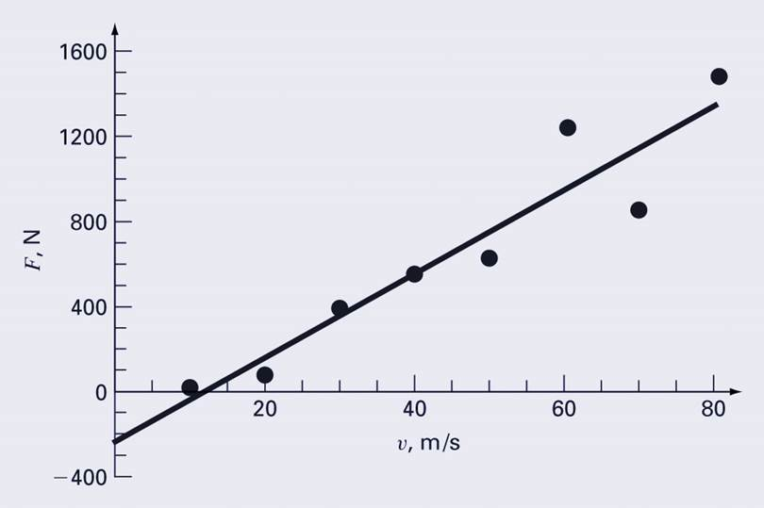

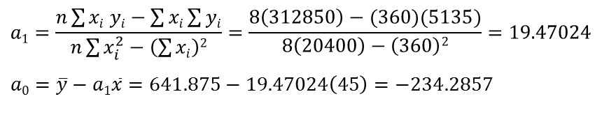
Least-Squares Fit of a Straight Line Example
 | V (m/s) | F (N)
i | x_{i} | y_{i} | (x_{i})² | x_{i}y_{i}
1 | 10 | 25 | 100 | 250
2 | 20 | 70 | 400 | 1400
3 | 30 | 380 | 900 | 11400
4 | 40 | 550 | 1600 | 22000
5 | 50 | 610 | 2500 | 30500
6 | 60 | 1220 | 3600 | 73200
7 | 70 | 830 | 4900 | 58100
8 | 80 | 1450 | 6400 | 116000
Σ | 360 | 5135 | 20400 | 312850
$$a1=\frac{n\sum{xi yi}−\sum{xi}\sum{yi}}{n\sum{x_{i}^{2}−\left(\sum{xi}\right)2}}=\frac{8\left(312850\right)−(360)(5135)}{8\left(20400\right)−\left(360\right)2}=19.47024$$
$$a0=\overline{y}−a1\overline{x}=641.875−19.47024\left(45\right)=−234.2857$$
$$Fest=−234.2857+19.47024v$$

Slide 6
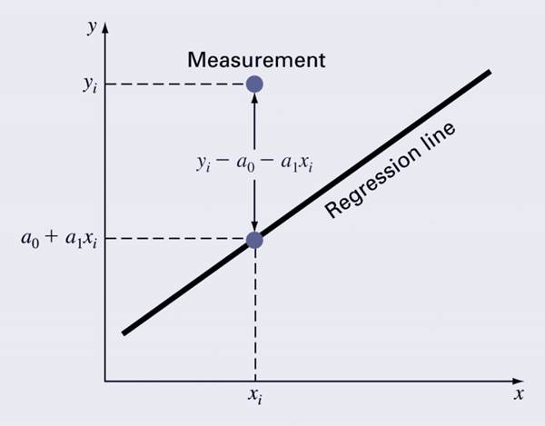
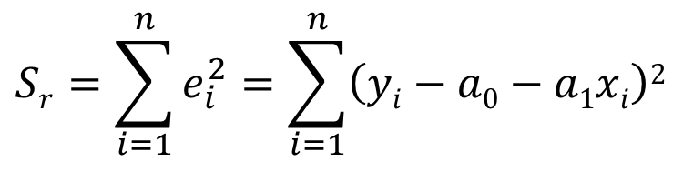

Quantification of Error
Recall for a straight line, the sum of the squares of the estimate residuals:
$$Sr=\sum_{i=1}^{n}{e_{i}^{2}=\sum_{i=1}^{n}{\left(yi−a0−a1xi\right)2}}$$
Standard error of the estimate:
$$sy/x=\sqrt{\frac{Sr}{n−2}}$$

Slide 7
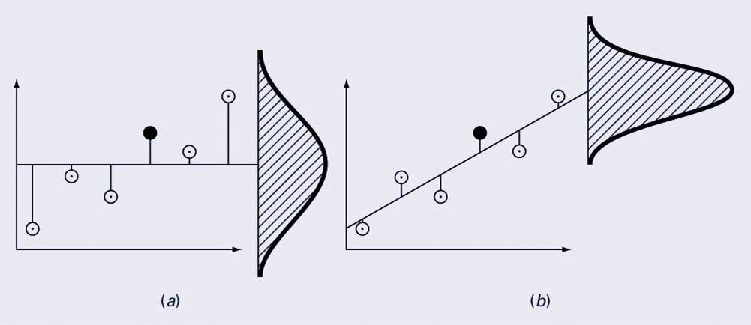
Standard Error of the Estimate
Regression data showing (a) the spread of data around the mean of the dependent data and (b) the spread of the data around the best fit line:
The reduction in spread represents the improvement due to linear regression.

Slide 8
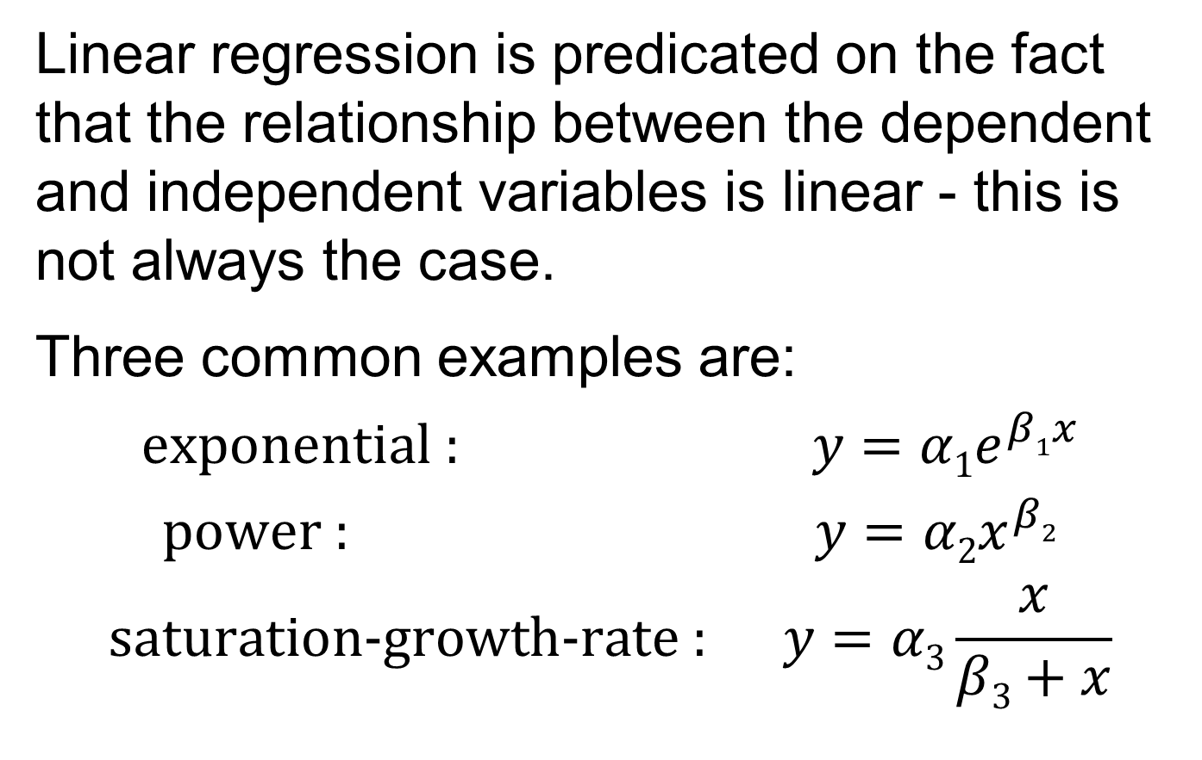
Nonlinear Relationships
Linear regression is predicated on the fact that the relationship between the dependent and independent variables is linear - this is not always the case.
Three common examples are:
$$\text{exponential}\text{ :} y={α1e}^{β1x}$$
$$\text{power}\text{ :} y={α2x}^{β2}$$
$$\text{saturation}\text{−}\text{growth}\text{−}\text{rate}\text{ :} y=α3\frac{x}{β3+x}$$

Slide 9
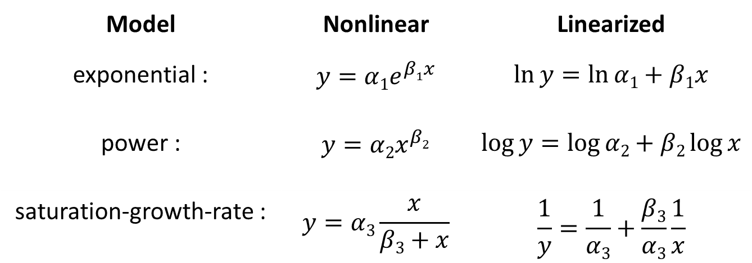
Linearization of Nonlinear Relationships
One option for finding the coefficients for a nonlinear fit is to linearize it. For the three common models, this may involve taking logarithms or inversion:
Model | Nonlinear | Linearized
exponential : | $$y={α1e}^{β1x}$$ | $$\ln{y=\ln{α1+β1x}}$$
power : | $$y={α2x}^{β2}$$ | $$\log{y=\log{α2+β2\log{x}}}$$
saturation-growth-rate : | $$y=α3\frac{x}{β3+x}$$ | $$\frac{1}{y}=\frac{1}{α3}+\frac{β3}{α3}\frac{1}{x}$$

Slide 10
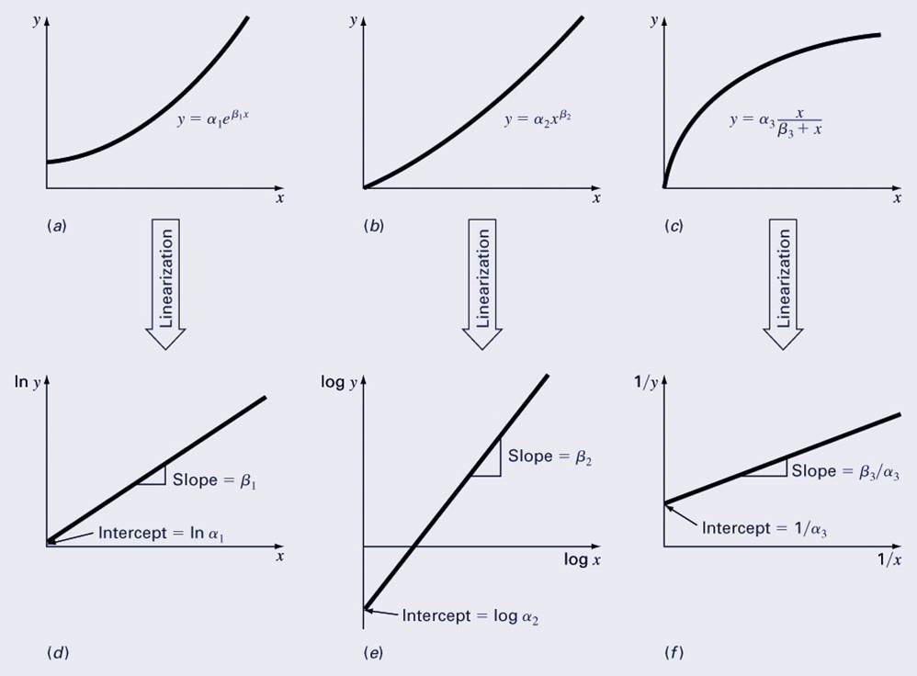
Transformation Examples

Slide 11
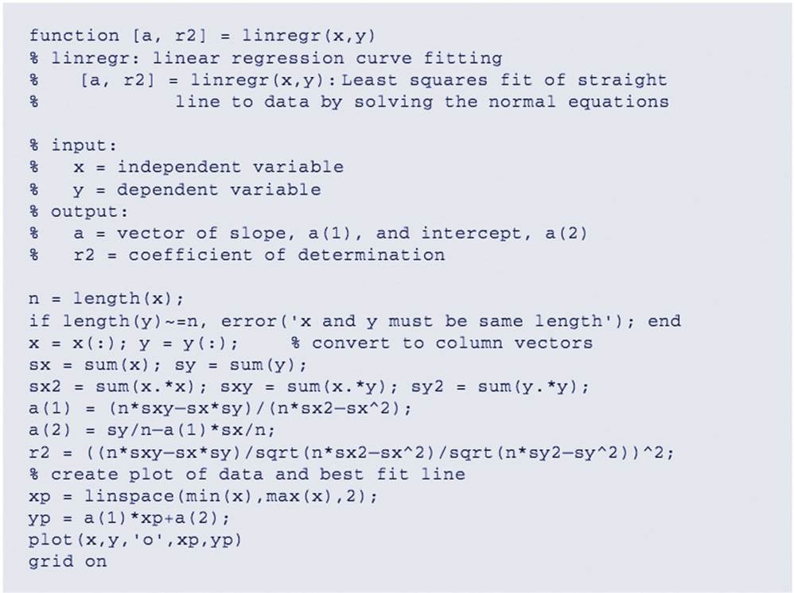
Linear Regression Program

Slide 12
MATLAB Functions
MATLAB has a built-in function polyfit that fits a least-squares nth order polynomial to data:
p = polyfit(x, y, n)
x: independent data
y: dependent data
n: order of polynomial to fit
p: coefficients of polynomial f(x)=p₁x^{n}+p₂x^{n-1}+…+p_{n}x+p_{n+1}
MATLAB’s polyval command can be used to compute a value using the coefficients.
y = polyval(p, x)

Slide 13
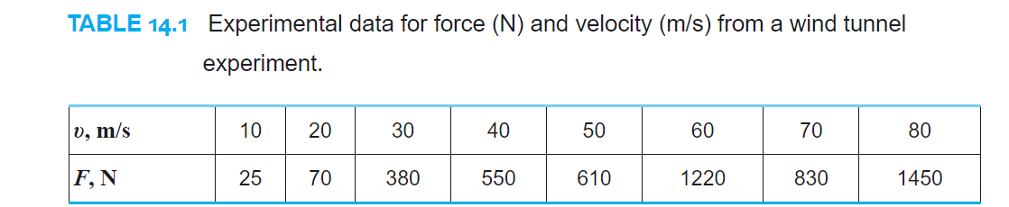
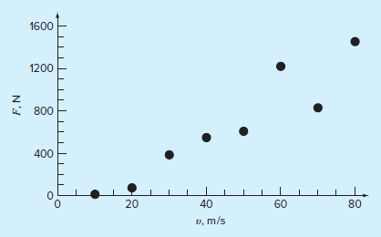
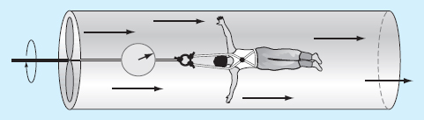
Example 14.4
Fit a straight line to the values of the Table 14.1.

Slide 14
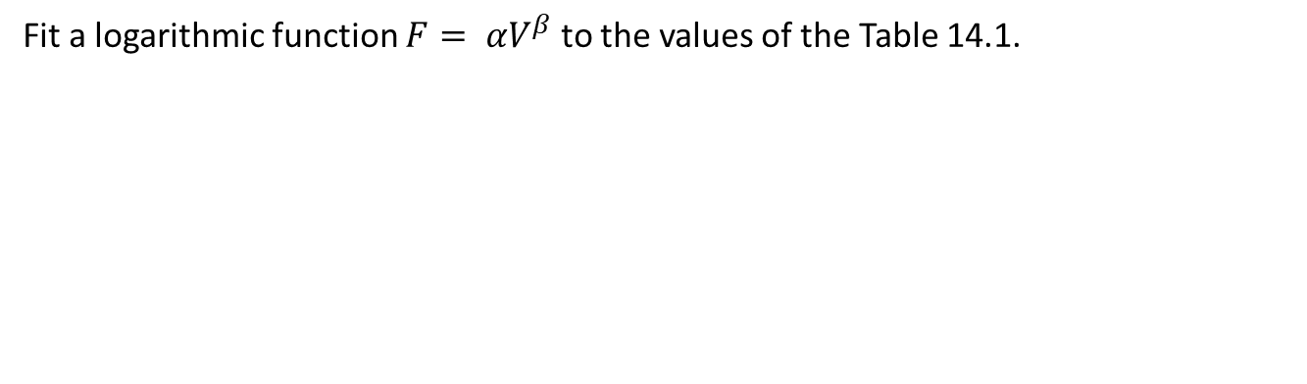
Example 14.6
Fit a logarithmic function $F= αV^{β}$ to the values of the Table 14.1.

Slide 15
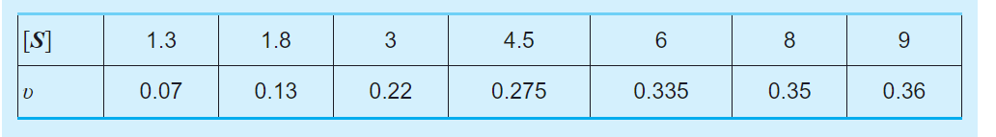
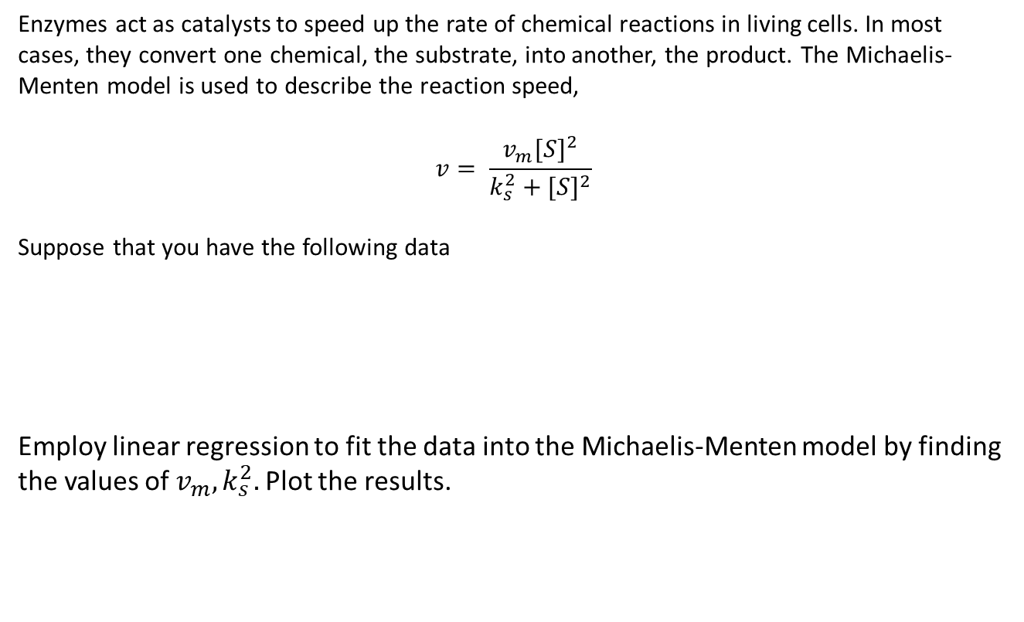
Case study 14.6
Enzymes act as catalysts to speed up the rate of chemical reactions in living cells. In most cases, they convert one chemical, the substrate, into another, the product. The Michaelis-Menten model is used to describe the reaction speed,
$$v= \frac{v_{m}{[S]}^{2}}{k_{s}^{2}+{[S]}^{2}}$$
Suppose that you have the following data
Employ linear regression to fit the data into the Michaelis-Menten model by finding the values of $v_{m}, k_{s}^{2}.$ Plot the results.

